Slide 1
Ankara University Computer Engineering Department COM3025 Microprocessors Lab 1
Fatıma Zehra Ünal

Slide 2
Q-1
Draw the block diagram of a computer system

Slide 3
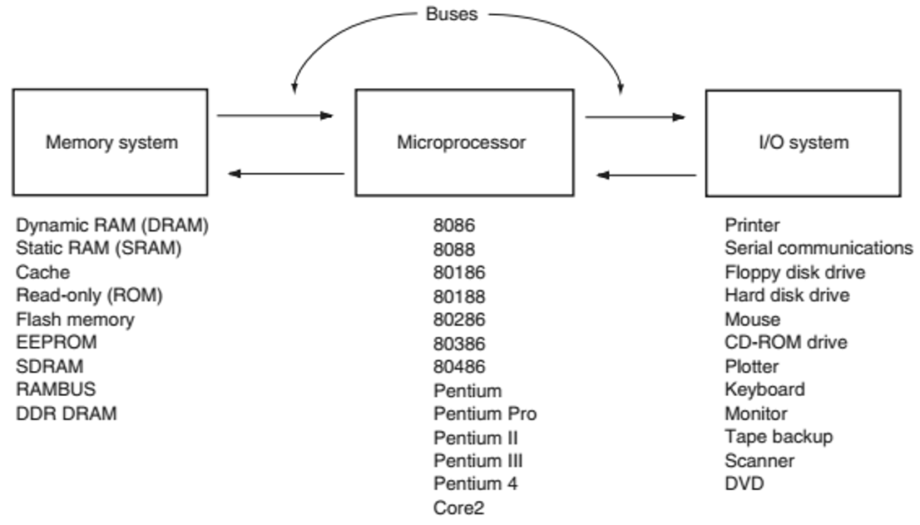
A-1
Draw the block diagram of a computer system

Slide 4
Q-2
List the three buses found in all computer systems.

Slide 5
A-2
List the three buses found in all computer systems.
Address Bus
Data Bus
Control Bus.

Slide 6
Q-3
What is the microprocessor?

Slide 7
A-3
What is the microprocessor?
The MP is the controlling element in a computer system which is also referred as CPU (Central Processing Unit). It controls memory and I/O through a series of connections called buses.
Notes:
MP or CPU is like the brain of a computer system.

Slide 8
Q-4
What is the significance of Intel 4004?

Slide 9
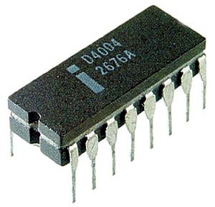
A-4
What is the significance of Intel 4004?
Intel 4004 is the first general-purpose programmable processor on the market.
Notes:
It is an integrated circuit. Means that it includes different circuit elements all together.

Slide 10
Q-5
What are the 3 main tasks that Microprocessor performs?

Slide 11
A-5
What are the 3 main tasks that Microprocessor performs?
Data transfer between itself and the memory or I/O system.
Simple arithmetic and logic instructions
Program flow via simple decisions.

Slide 12
Q-6
What are the parts of the memory system?

Slide 13
A-6
What are the parts of the memory system?
TPA (Transient Program Area)
System Area
XMS (Extended Memory System)

Slide 14
Q-7
What are the arithmetic and logic operations that microprocessor performs?

Slide 15
A-7
What are the arithmetic and logic operations that microprocessor performs?
Addition,
Subtraction,
Multiplication,
Division,
AND,
OR,
NOT,
NEG,
shift,
rotate

Slide 16
Q-8
Convert the following binary numbers into decimal:
1101.01
111001.101

Slide 17
A-8
Convert the following binary numbers into decimal:
1101.01
1x2³ + 1x2² + 0x2¹ + 1x2⁰ + 0x2⁻¹ + 1x2⁻² = 13.25
111001.101
1x2⁵ + 1x2⁴ + 1x2³ + 0x2² + 0x2¹ + 1x2⁰ + 1x2⁻¹ + 0x2⁻² + 1x2⁻³ = 57.625

Slide 18
Q-9
Convert the following octal numbers into decimal:
12.3
123.4

Slide 19
A-9
Convert the following octal numbers into decimal:
12.3
1x8¹ + 2x8⁰ + 3x8⁻¹ = 10.375
123.4
1x8² + 2x8¹ + 3x8⁰ + 4x8⁻¹ = 83.5

Slide 20
Q-10
Convert the following hexadecimal numbers into decimal
A3.3
AC.DC

Slide 21
A-10
Convert the following hexadecimal numbers into decimal
A3.3
10x16¹ + 3x16⁰ + 3x16⁻¹ = 163.1875 (1/16=0,0625)
AC.DC
10x16¹ + 12x16⁰ + 13x16⁻¹ + 12x16⁻² = 172.859375 ((1/16)²=0,0390625)

Slide 22
Q-11
Convert the following decimal integers into binary, octal, and hexadecimal
23
173

Slide 23
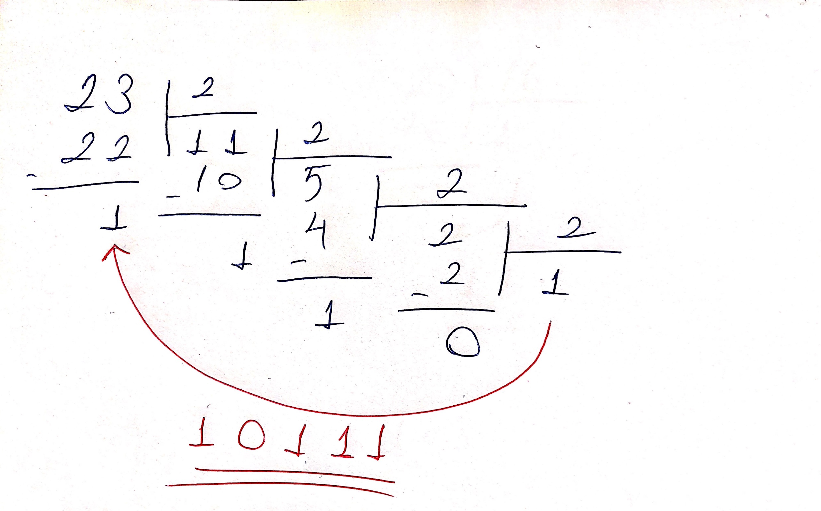
Q-11
Convert the following decimal integers into binary, octal, and hexadecimal
23

Slide 24
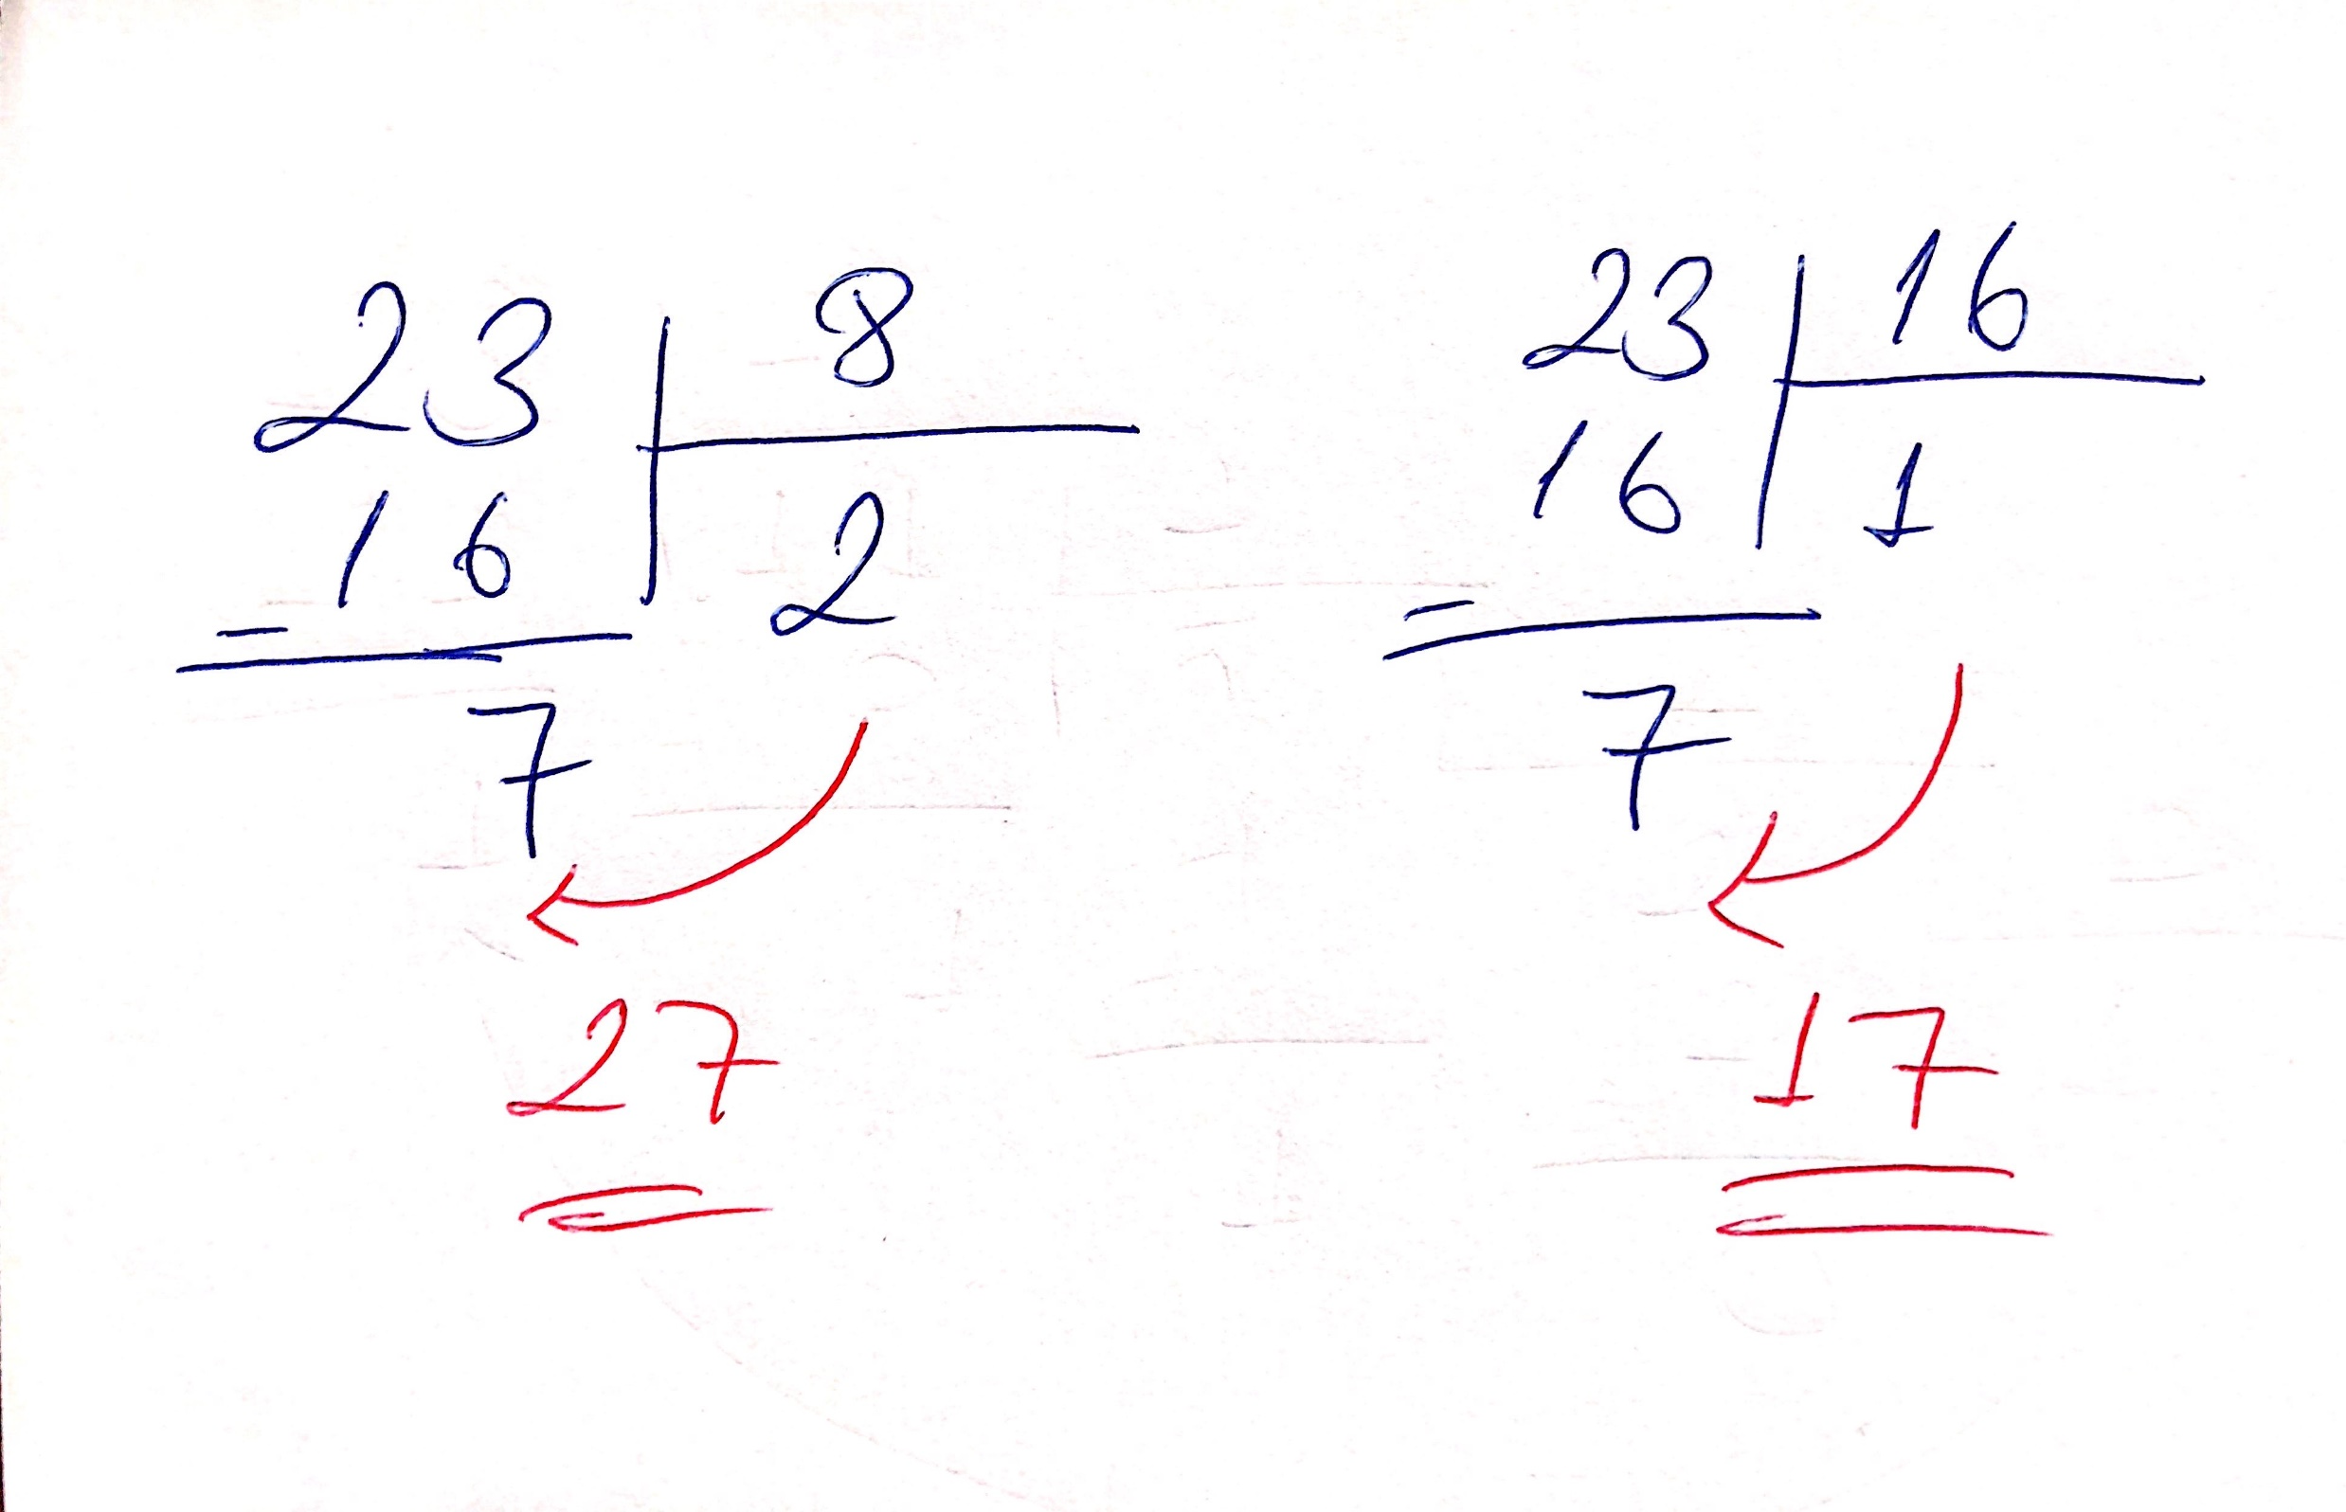
Q-11
Convert the following decimal integers into binary, octal, and hexadecimal
23

Slide 25
Q-11
Convert the following decimal integers into binary, octal, and hexadecimal
Decimal | Binary | Octal | Hex
23 | 10111 | 27 | 17

Slide 26
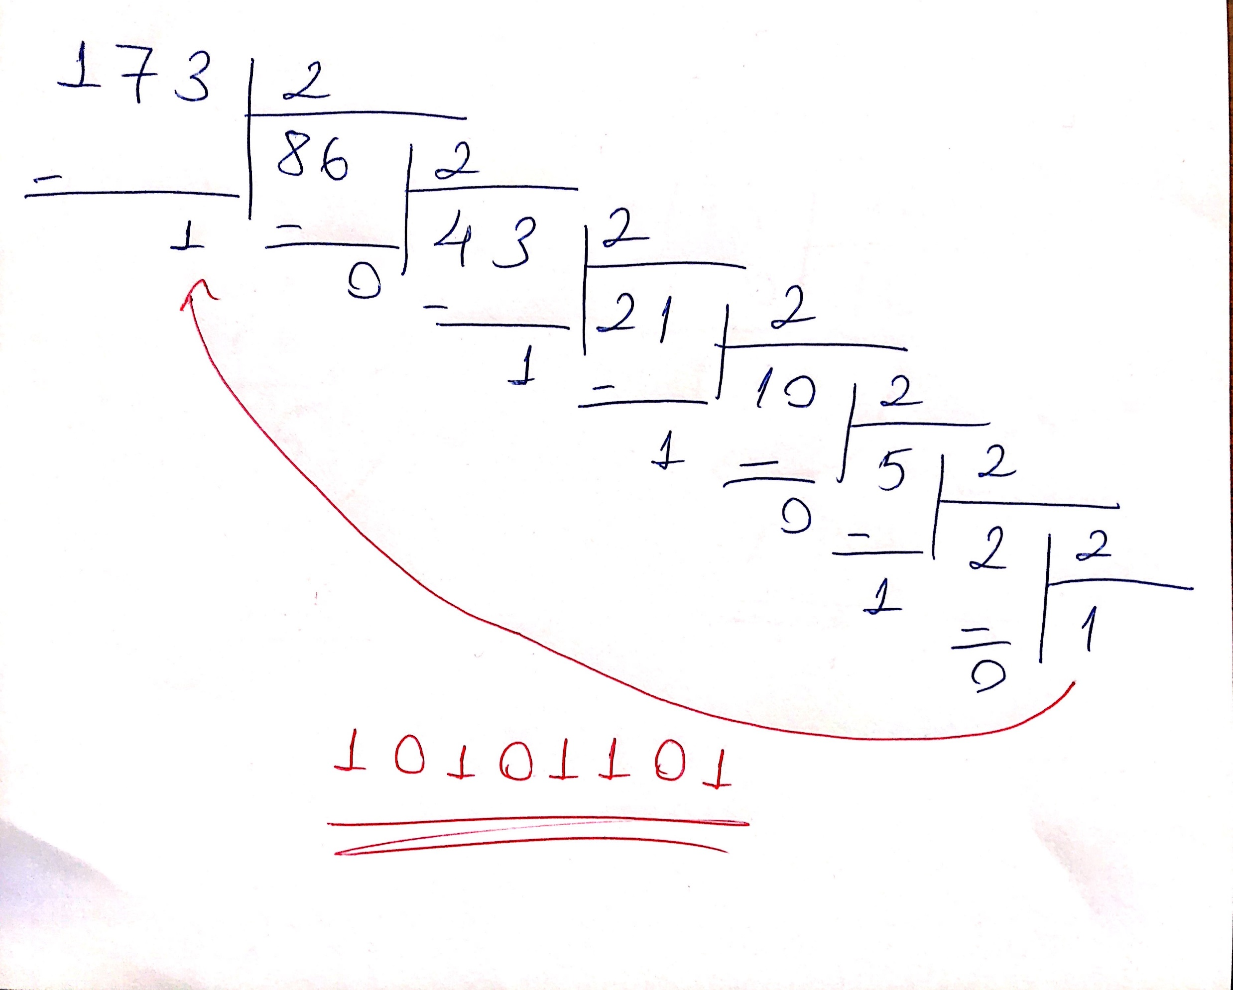
Q-11
Convert the following decimal integers into binary, octal, and hexadecimal
173

Slide 27
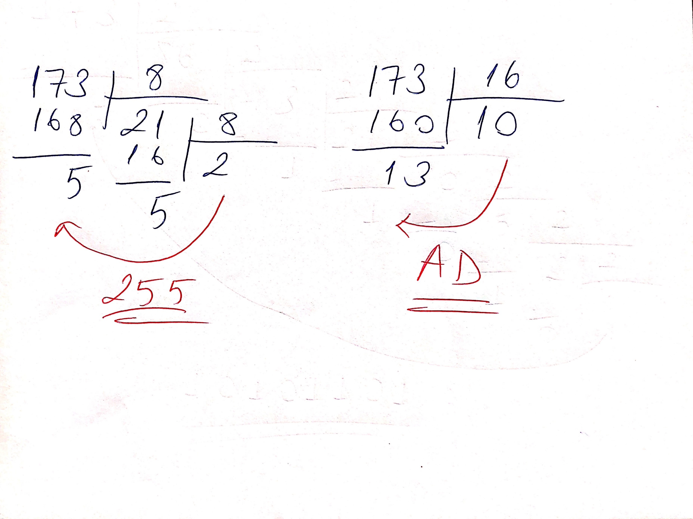
Q-11
Convert the following decimal integers into binary, octal, and hexadecimal
173

Slide 28
Q-11
Convert the following decimal integers into binary, octal, and hexadecimal
Decimal | Binary | Octal | Hex
173 | 10101101 | 255 | AD

Slide 29
Q-12
Convert the following decimal numbers into binary, octal, and hexadecimal
0.75
0.375

Slide 30
Q-12
Convert the following decimal numbers into binary, octal, and hexadecimal
0.75
Binary
0.75 x 2 = 1.5 (Decimal part: 1, Fractional part: 0.5)
0.5 x 2 = 1.0 (Decimal part: 1, Fractional part: 0.0 [Stop!])
Result: 0.11 (You need to write decimal parts up to down)
Octal
0.75x8=6.0 (Decimal part: 6, Fractional part: 0.0 [Stop!])
Result: 0.6
Hex
0.75x16=12.0 (Decimal part: 12, Fractional part: 0.0 [Stop!])
Result: 0.C

Slide 31
Q-12
Convert the following decimal numbers into binary, octal, and hexadecimal
0.375
Binary
0.375 x 2 = 0.75 (Decimal part: 0, Fractional part: 0.75)
0.75 x 2 = 1.5 (Decimal part: 1, Fractional part: 0.5)
0.5 x 2 = 1.0(Decimal part: 1, Fractional part: 0.0 [Stop!])
Result: 0.011 (You need to write decimal parts up to down)
Octal
0.375x8=3.0 (Decimal part: 3, Fractional part: 0.0 [Stop!])
Result: 0.3
Hex
0.375x16=6.0 (Decimal part: 6, Fractional part: 0.0 [Stop!])
Result: 0.6

Slide 32
Q-12
Convert the following decimal numbers into binary, octal, and hexadecimal
What about 0.13?
Binary
0.13 x 2 = 0.26 (Decimal part: 0, Fractional part: 0.26)
0.26 x 2 = 0.52 (Decimal part: 0, Fractional part: 0.52)
0.52 x 2 = 1.04 (Decimal part: 1, Fractional part: 0.04)
0.04 x 2 = 0.08 (Decimal part: 0, Fractional part: 0.08)
0.08 x 2 = 0.16 (Decimal part: 0, Fractional part: 0.16)
0.16 x 2 = 0.32 (Decimal part: 0, Fractional part: 0.32)
… (Very Long) Result: 0.001000…

Slide 33
Q-13
Convert the following binary numbers to the one’s complement form
1000 1000
0101 1010

Slide 34
A-13
Convert the following binary numbers to the one’s complement form
Original | 1000 1000 | 0101 1010
One’s Complement | 0111 0111 | 1010 0101

Slide 35
Q-14
Convert the following binary numbers to the two’s complement form:
1000 0001
1010 1100

Slide 36
A-14
Convert the following binary numbers to the two’s complement form:
Original | 1000 0001 | 1010 1100
One’s Complement | 0111 1110 | 0101 0011
Two’s Complement | 0111 1111 | 0101 0100

Slide 37
Q-15
Convert the following hexadecimal numbers to Binary Coded Hexadecimal form:
7CF
E9A.B

Slide 38
A-15
Convert the following hexadecimal numbers to Binary Coded Hexadecimal form:
7CF = 0111 1100 1111
E9A.B = 1110 1001 1010. 1011

Slide 39
Q-16
Convert the following BCH numbers to hexadecimal form:
0100 1100 1111
0011 . 0111

Slide 40
A-16
Convert the following BCH numbers to hexadecimal form:
0100 1100 1111 = 4CF
0011 . 0111 = 3.7

Slide 41
Q-17
What are the 8-bit Registers? What are the 16-bit Registers?
8 bit registers:
16 bit registers:

Slide 42
A-17
What are the 8-bit Registers? What are the 16-bit Registers?
• 8 bit registers: AH, AL, BH, BL, CH, CL, DH and DL
• 16 bit registers: AX, BX, CX, DX, SP, BP, DI, SI, IP, FLAGS, CS, DS, ES, SS, FS, GS

Slide 43
Q-18
What are the multipurpose registers?

Slide 44
A-18
What are the multipurpose registers?
The multipurpose registers include AX, BX, CX, DX, BP, DI and SI.
AX (Accumulator)
BX (Base Index)
CX (Count)
DX(Data)
BP(Base Pointer)
DI(Destination Index)
SI(Source Index)

Slide 45
Q-19
What are the Segment Registers?

Slide 46
A-19
What are the Segment Registers?
CS (Code Segment)
DS (Data Segment)
ES (Extra Segment)
SS (Stack Segment)

